Slide 1

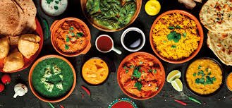
Fridge Fren
The Friendly Recipe Search
Application
May 2023
Daniel S, Federico Dordoni and Natalie Campbell
Eat great. Feel greater!

Slide 2
Fridge Fren
Are you tired of staring at a fridge full of random ingredients and not knowing what to make for dinner?
Fridge Fren® is here to save the day, night or dish!
Our friendly app provides a wide range of recipes based on the ingredients you have on hand, allowing you to make delicious and creative meals without wasting food or breaking the bank. With Fridge Fren, cooking has never been easier or more fun!
Eat great. Feel greater!

Slide 3
Concept
The application allows you to search for recipes based of ingredients, cuisines and recipe names and gives you the recipe ingredients, instructions, nutritional information and videos on how to make.
Fridge Fren is a recipe app that helps users create delicious meals using the ingredients they already have in their fridge. By simply inputting the ingredients they have on hand, the app provides recipe suggestions that use those ingredients, reducing food waste and saving time and money. With a vast database of recipes and the ability to save favorite recipes, Fridge Fren encourages users to experiment with new ingredients and cooking methods, making cooking an exciting and creative experience.
The application aims to/is designed to help users reduce food waste, cut living costs and save time by making the process of finding recipes simple.
Eat great. Feel greater!

Slide 4
User Story
AS A foodie… I WANT TO create new recipes based off what I have in my fridge
SO THAT I can save money and time
WHEN I enter an ingredient in the search bar
THEN I am presented with an array of choices (recipes) relevant to the search input
WHEN I click on one of them
THEN I am presented with the recipe instructions with all its data (cooking method, ingredients, calories, time, cuisine)
WHEN I click on the Add To Favorite
THEN the relevant recipe gets saved in my local storage
SO THAT it can be restored at a later date
Eat great. Feel greater!

Slide 5
Process
Technologies used
User inputs ingredients they have on hand into Fridge Fren's search bar.
Fridge Fren uses the Spoonacular API to search for recipe ideas based on those ingredients.
The app displays a list of recipe suggestions that match the ingredients entered by the user.
Users can filter the results based on dietary preferences or cuisine type.
Once a recipe is selected, Fridge Fren provides step-by-step instructions and a list of additional ingredients needed, if any.
Users can save their favorite recipes for future reference.
Fridge Fren also utilizes the TikTok API to display popular cooking videos related to the ingredients entered by the user, providing additional inspiration and guidance for the cooking process.
(Users can share their creations on social media and connect with other Fridge Fren users to share tips and ideas.) - OPTIONAL - we haven't done (yet)
Overall, Fridge Fren's process is designed to make cooking more accessible, creative, and fun, while also reducing food waste and promoting sustainable cooking practices.
Eat great. Feel greater!

Slide 6
Breakdown of tasks and roles
The development of the app had stages of planning, development and testing. The planning was assigned to all using Lucidspark wireframe and flowchart while the development was split into three pages, each team member assigned to one page: home page, search page and results page.
During development, the three pages were merged for user experience. Each team member was involved in the overall design and testing of the app. The API’s originally selected proved a hurdle, and the
Eat great. Feel greater!

Slide 7
Challenges
Tiktok api key permission denied, had to use tiktok dev tools embed
Decided that the TikTok embed wasn’t a true API call
Redesigned the second API
Github process of using version control
MAC vs windows users
Eat great. Feel greater!

Slide 8
Successes
Functioning search button
Pulling API recipes
Modal for redirection
Recipes
Eat great. Feel greater!

Slide 9
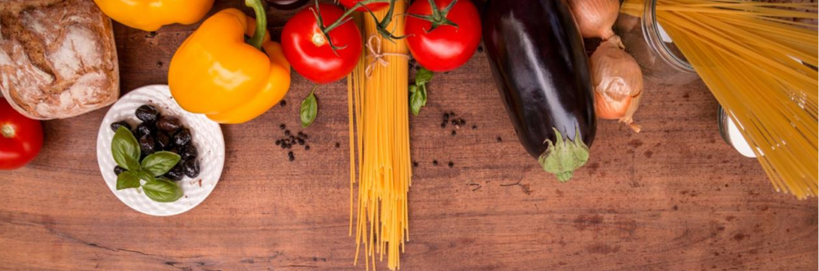
DEMO
Eat great. Feel greater!

Slide 10
Directions for Future Development
Expanding the search to use other parameters such as cost or time
Linking the meal planner to smart fridges for shopping lists
Creating a pantry to select all user’s pantry items
Social links
Profile creation
Tiktok API/token
Eat great. Feel greater!

Slide 11
Links
Deployed URL:
https://github.com/stanno03/Fridge-Fren
Eat great. Feel greater!

